Slide 1
Understanding
Quantiztion
Prunning
Knowledge Distillation
knowledge
training
LoRa

Slide 2
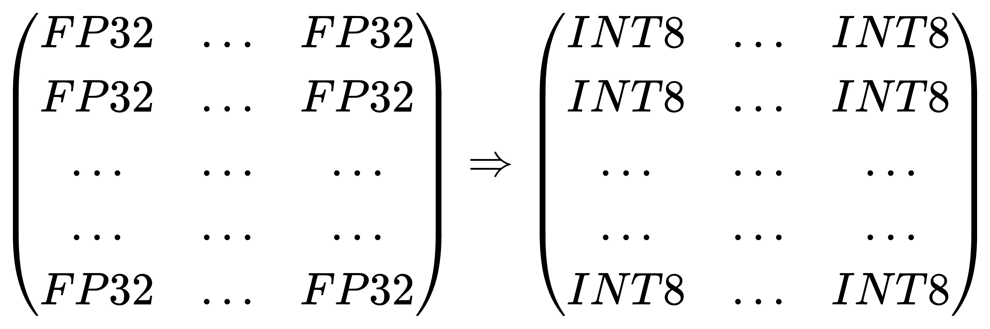
Quantization
lower bits for parameters in LLM
faster loading, calculation
less memory space needed
but lower precision

Slide 3
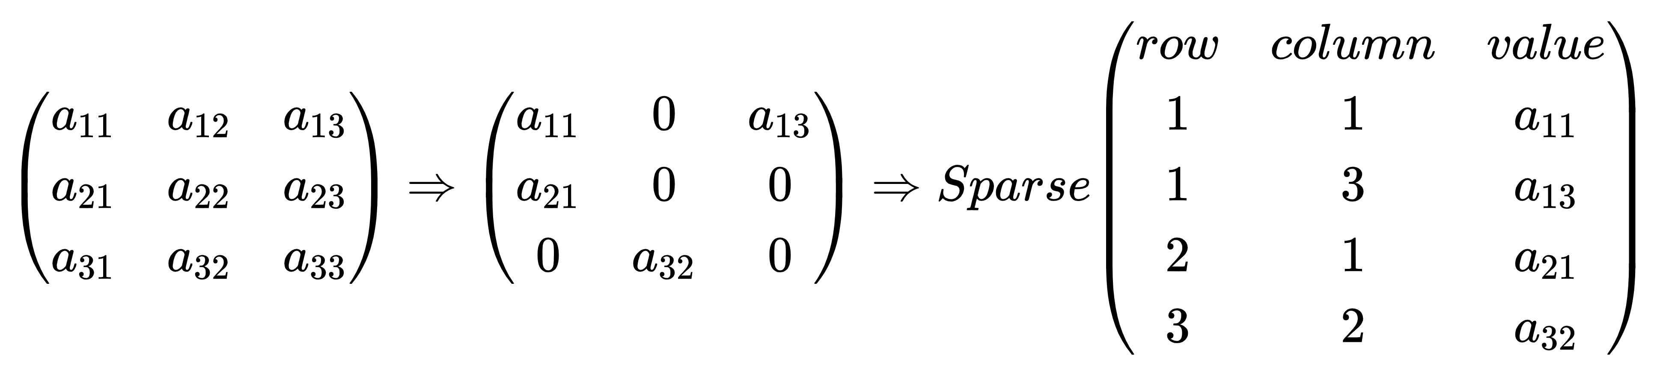
Prunning
drop some useless parameters or channels, increase sparsity
faster loading, calculation
less memory space needed
but lower precision

Slide 4
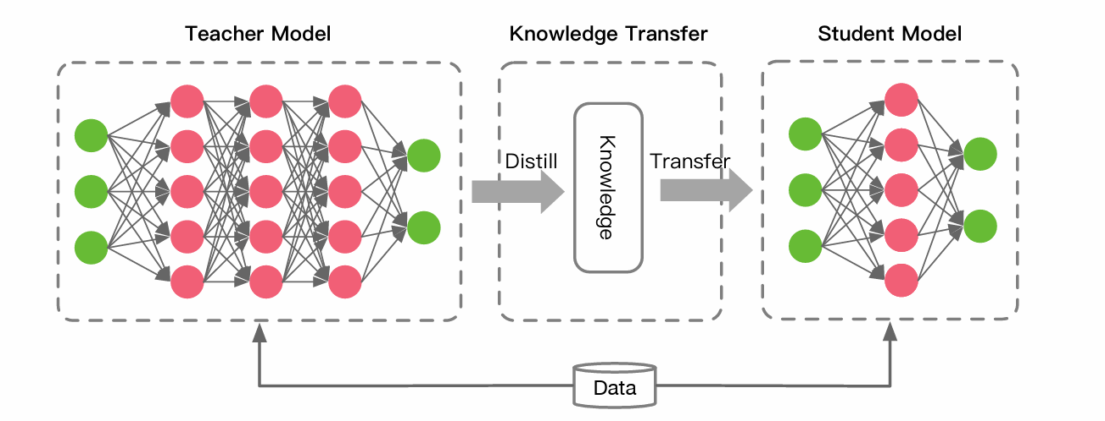
Knowledge Distillation
transfer knowledge distilled from bigger models(Teacher Model) to smaller models(Student Model).

Slide 5
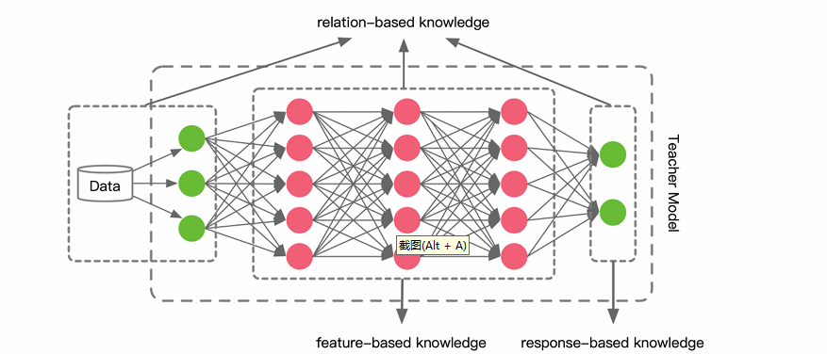
Knowledge Types
response-based knowledge
feature-based knowledge
relation-based knowledge

Slide 6
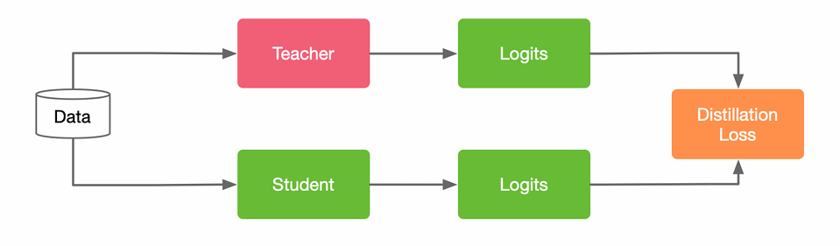
Response-based knowledge
Student model learn to mimic the output of the Teacher model.
Distillation Loss:the difference between the logits(soft label) of student and the teacher model.

Slide 7
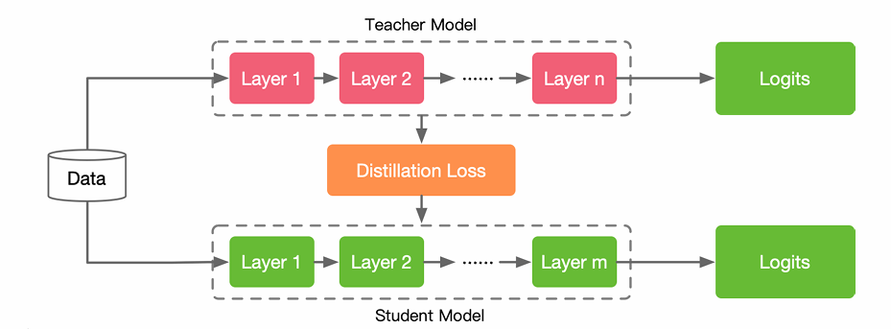
Feature-based knowledge
Student model learn to mimic the intermediate layer of the Teacher model.
Distillation Loss:difference between the feature activations of teacher and student.
Hard to decide which layers in teacher model to guide layers in Student model.

Slide 8
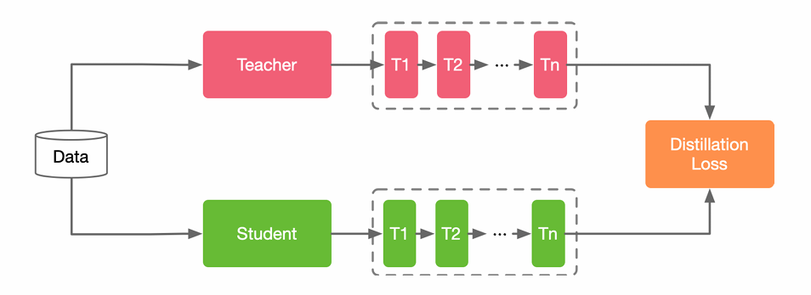
Relation-based knowledge
Student model learn to mimic the structure of outputs of the Teacher model.
Distillation Loss:difference between the relationship of outputs from teacher and student.

Slide 9
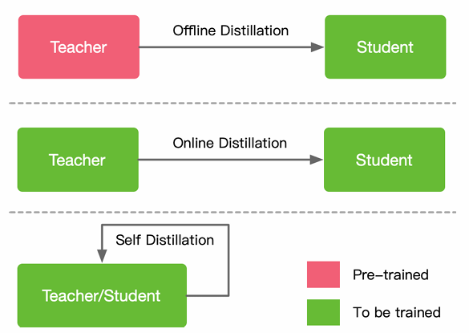
Different way of training
Offline Distillation
Online Distillation
Self-Distillation

Slide 10
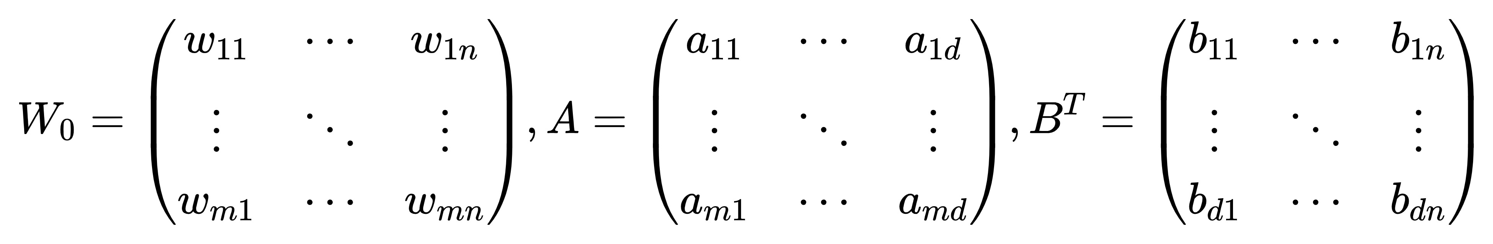
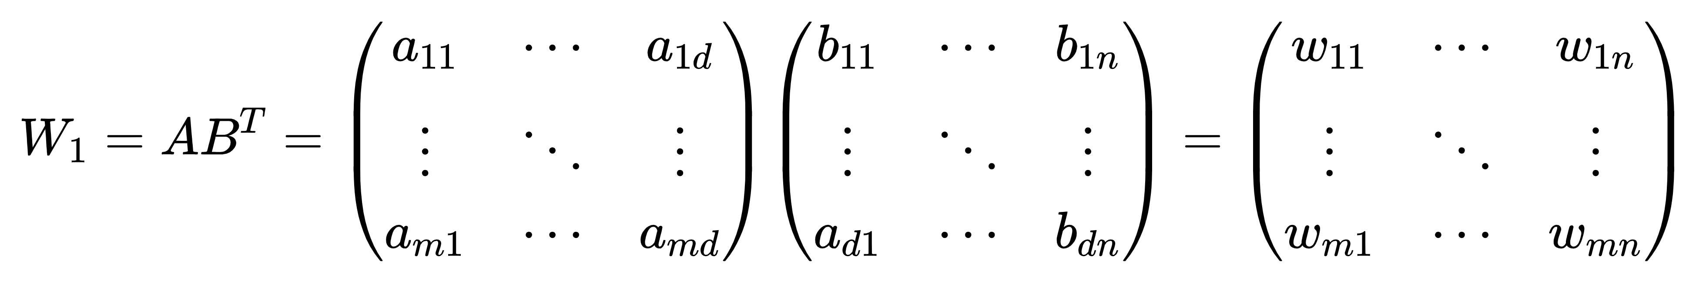
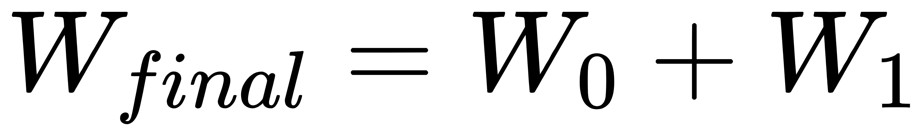
LoRa(Low-Rank Adaptation)
For pretrained weight matrix W_0 with shape (m,n), training matrix A and B that AB^T=W_1 with same shape as W_0.
d is much smaller than m and n.

